Slide 1

<CHAMBER NAME>
The Voice For Business in <COMMUNITY NAME>

Slide 2

Why Advocacy?
Member Value
  What does the Chamber do for me?
Large Investor Interest
  What does the Chamber do for the community?
Voice for Business
  Elected leaders look to us to advocate for a better business community
Notes:
First, I want to touch on the organizational value of advocacy.
It provides us an additional value proposition. For the member who can’t attend events, it provides something for us to talk about at renewal time. By being the voice for business and providing our members with information about the policy proposals that could impact their business, we create value for our members.
This is especially true for our members who are contributing more to the Chamber. In the Chamber industry, we have found that larger businesses often care more about community impact than direct ROI. They want to contribute to advocacy focused organizations.
Finally, advocacy is one of the main reasons chambers exist. Businesses need their interests represented with elected officials and few can do it themselves. If the Chamber of Commerce isn’t the voice for business, business has no voice.

Slide 3

Brand Building
  What sets the Chamber apart?
  What value do we provide?
Why Advocacy?
If not us, then who?
  Who advocates for business in our community?
Notes:
It builds our brand and strengthens our position within the business community. Chambers with advocacy programs have a stronger position within their community.
But ultimately, it is a need that must be met. We can

Slide 4

Step 1:
Commitment
Define what Advocacy is.
Define what Advocacy is not.
Notes:
So how do we become an advocating chamber?
First let’s get on the same page about what we are talking about. Advocacy is about policy, not politics. It is about working with our elected officials to educate them about how the decisions they make will impact the business community. It isn’t endorsing candidates. It isn’t getting involved with issues based on who supports them or who doesn’t. It is about defining what is important to our members and what will impact their business, and then advocating on those issues.

Slide 5

Step 2: Team Building
Create a Public Policy/Advocacy Committee/
Task Force.
- Government/Community Affairs Professionals
- Business Leaders
- Leadership Program Graduates
Notes:
Once we commit to advocacy, the next step is building a team to identify the policies we want to promote. It is crucial that the process be member driven and not staff driven. It isn’t about what I want, its about what you, our volunteer leaders want. We’ve listed the types of people who could be part of such a committee.

Slide 6

Step 3:
Issue Identification
and
Legislative Agenda
Look at other Chambers.
Survey our members.
Work with our local government.
Guiding Principles and Action Items.
Notes:
How will we identify issues? As I mentioned, our members will lead this process. We can do a survey to ask our general membership what their priorities are. We can talk to the town and the county to see if they are seeking legislation that the business community supports. We can look at what other chambers are focusing on. This all leads to the creation of a legislative agenda and policy guiding principles.

Slide 7

Step 4:
Share the Agenda
Share Legislative Agenda with Members and Legislators
Legislative Breakfast
Small Group Meetings
State Capital Trip
Notes:
Once we have an agenda, it gives us other opportunities for member engagement. Chambers will put it on their website, which again builds their brand. We could have a legislative breakfast, where we invite our legislators to talk to our members about our priorities. We may meet with policy makers in small groups. We might take a couple of members to Raleigh.

Slide 8

Board Updates
Video Updates
Action Alerts
Step 5: Report
Notes:
Finally, we report back. Our board will get regular updates. We can have video updates to our membership on a regular basis. We may send an action alert to our members, telling them that our legislators need to hear from them about an item that the Chamber is supporting.

Slide 9

Chamber Advocacy
Impact
Better Member Retention
Event Revenue
Advocacy Fund Sponsorship
Advertisement
Notes:
Ultimately, as I mentioned at the beginning, by engaging in advocacy, we will strengthen our chamber through better member retention, additional event revenue, sponsorships and advertisements.

Slide 10

Recap
5 Steps:
  Commit
  Team Build
  Identify Agenda
  Communicate Positions
  Report on Results
Provide Value and
Generate Revenue
Notes:
To recap, this is what we need to do.
Next, let’s look at how we do it.

Slide 11

3 Pathways to Advocacy
Do it ourselves
  No additional cost, very staff time intensive, lack expertise
Hire a consultant
  Large investment, bring in expertise, less staff time
Advocacy Framework
  Online training program with 25+ videos, templates, scripts and draft agendas.
  Small investment, build staff expertise
Notes:
This slide shows three different ways that we could launch our advocacy program. The first two I think are fairly self explanatory. I could try to do the whole thing myself. But that would be very time intensive, and its not my expertise. We could also hire an outside consultant to facilitate the whole process. That would be cost prohibitive for us.
I want to tell you a little about the third idea.

Slide 12

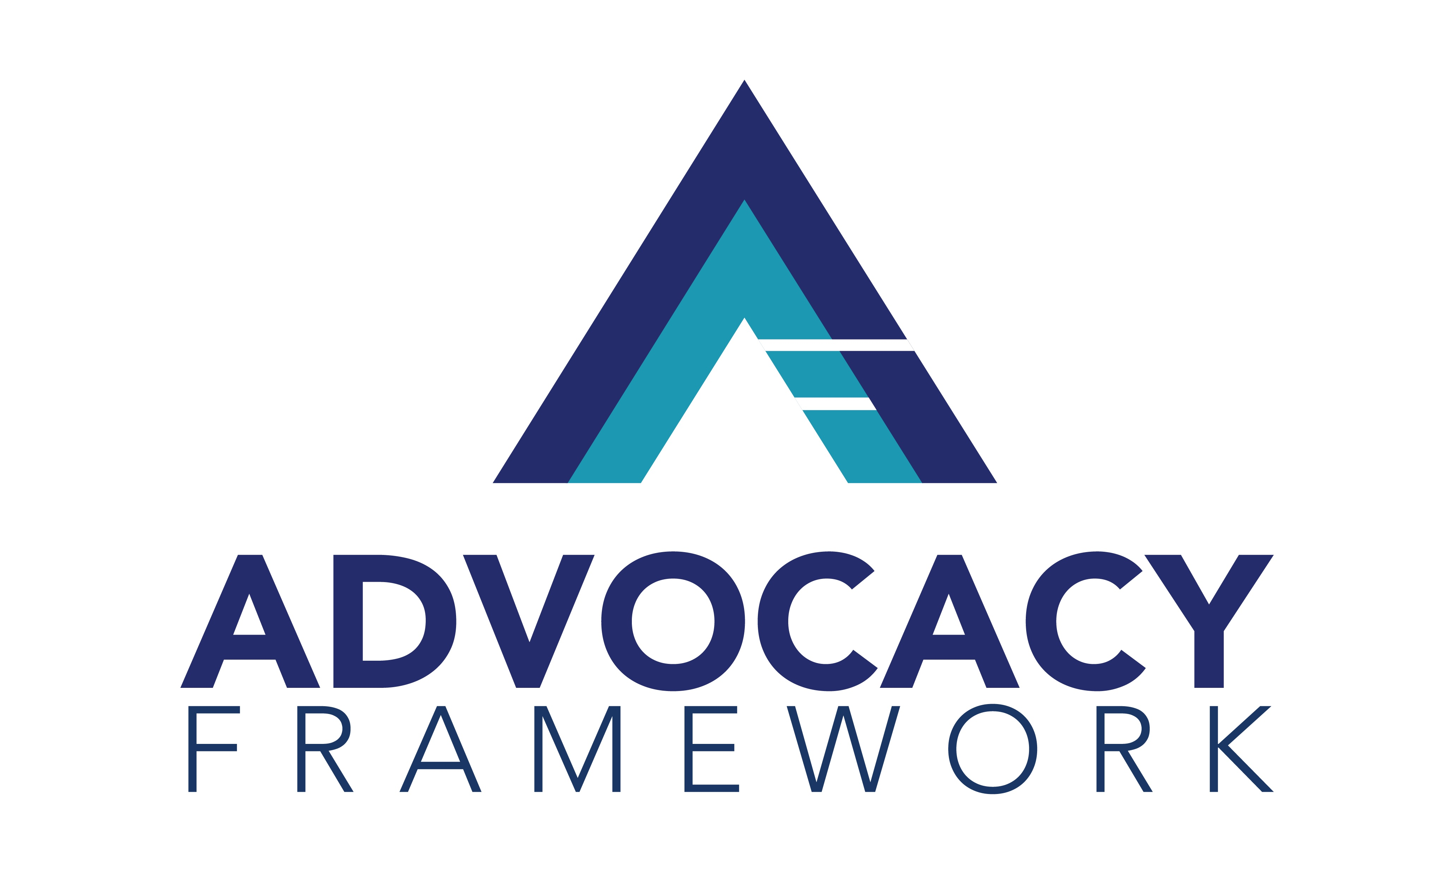
12-month program
We receive:
  Video lessons
  Email templates
  Meeting agendas
  Resource guides
  Twice monthly accountability/group coaching sessions
  Quarter 1:1 coaching
Goal: Stand up an advocacy program with a robust legislative agenda and member engagement
Notes:
Advocacy Framework is an online training program for Chambers like ours that want to be more involved in public policy but lack either the capacity or the expertise to stand up a program on our own. The program includes more than 25 individual lessons in modules built around creating a legislative agenda, monitoring legislation, creating public policy events and communicating with legislators. To help us achieve that, we will be provided draft meeting agendas, draft emails, checklists, and templates. Also, we will have group coaching sessions that we can participate in twice per month to help us if we get stuck.

Slide 13
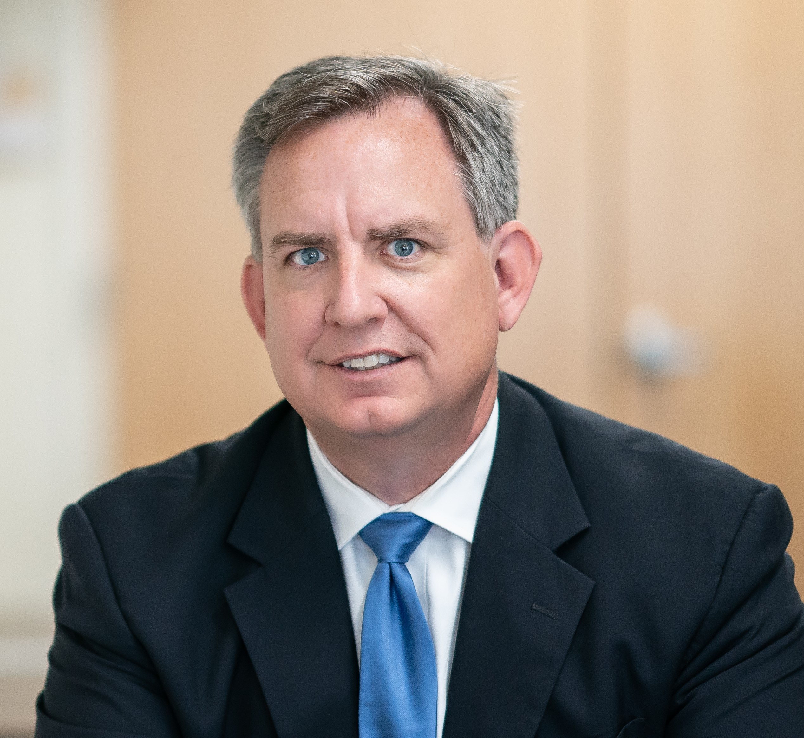

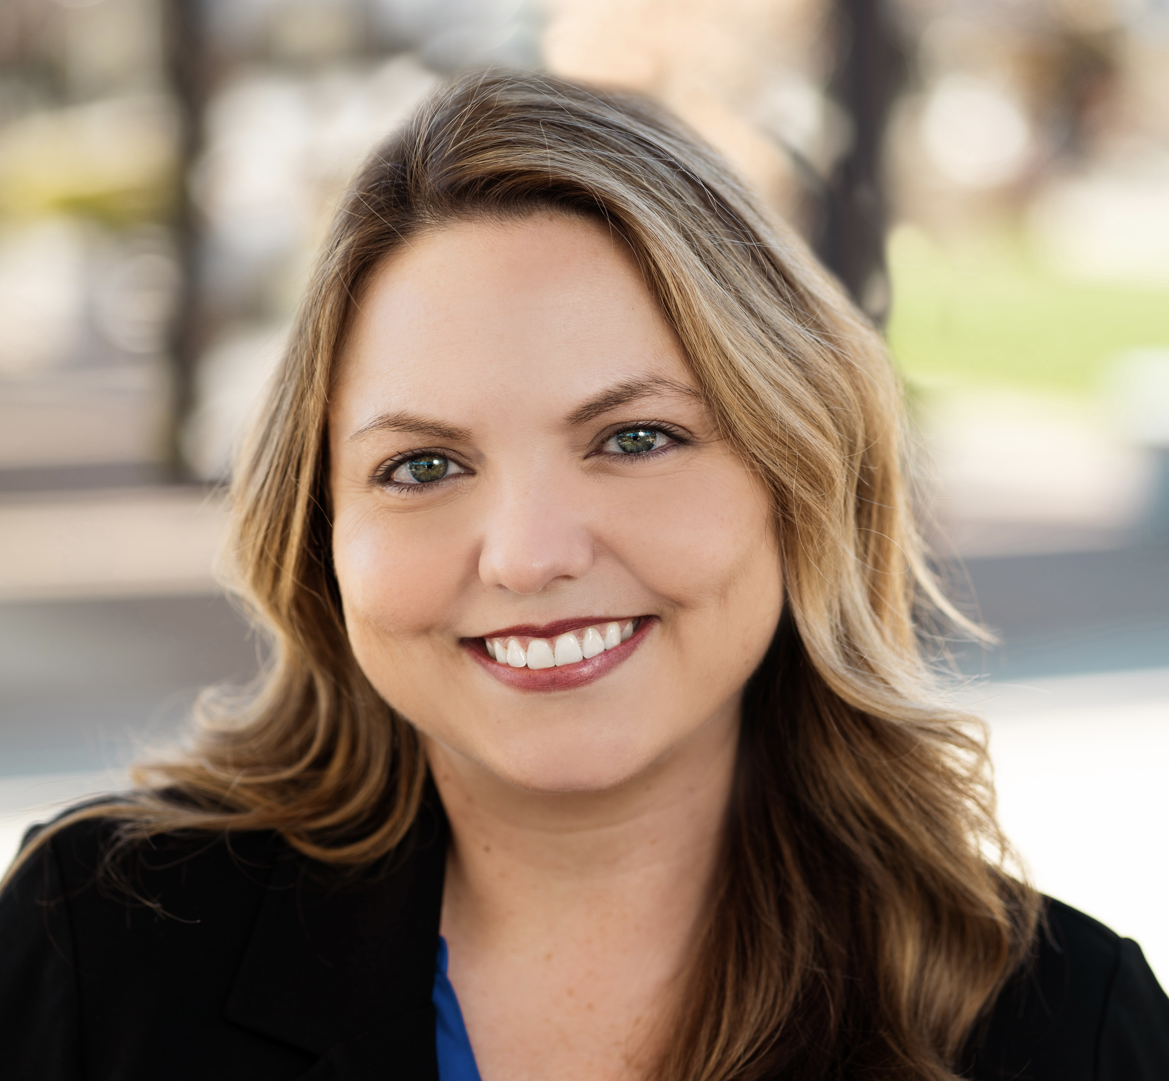
Brian Francis, President
Founded in 2016
Advocacy team with 40 years experience
Public Policy programming consultants
Headquartered in North Carolina
Sarah Prencipe, Advocacy Strategist
Notes:
The Advocacy Framework is a product of a company called Lumin Strategies. We’ll be working with Brian Francis, who owns Lumin and Sarah Prencipe (Prence a pee) who is an advocacy strategist with Lumin.
Between the two of them, they have 40 years government relations and public policy experience. Lumin provides public policy consulting services to Chambers of Commerce. Brian previously served as VP of Public Policy Programs at the Charlotte Chamber of Commerce and Lumin currently consults with several Chambers to implement policy programs.
They developed the Advocacy Framework training program as a way to take the expertise that they offer to their consulting clients and share it more broadly.

Slide 14
Budget and Next Steps
Program costs $500/month for 12 months ($6,000)
Discount of $1,000 if paid in advance
Enrollment now open
Notes:
As you see, this program will cost either $500/month for a 12 month commitment or $5,000 if paid upfront.
There is an enrollment period. We expect the next enrollment period to be in January.

